Slide 1
Development of an Android Application for Pavement Roughness Estimation
Team SDMAY20-17
Tanner Dempsay, Greg Starr, Joseph Van Treeck, Kyle Eckrich, Christian Royston, Justen Kuennen
Client
Program for Sustainable Pavement Engineering & Research (PROSPER) at Institute for Transportation, Bo Yang
Advisor
Halil Ceylan

Slide 2
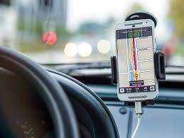
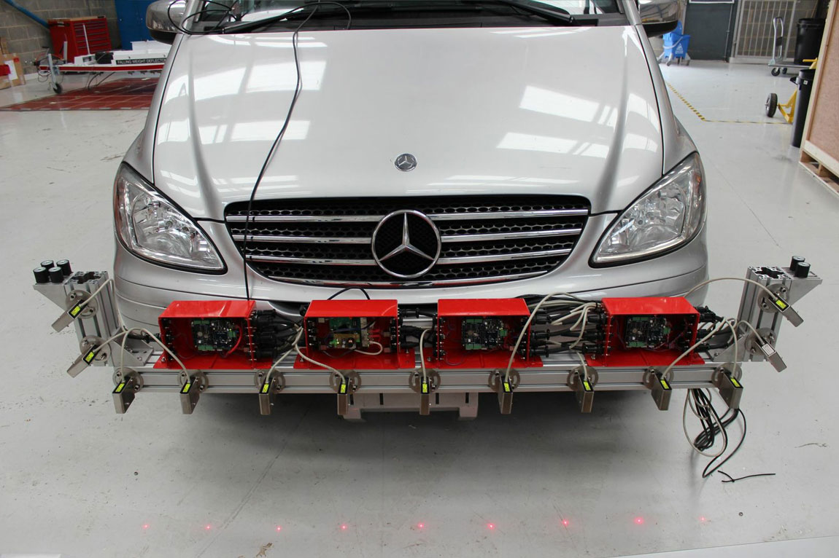
Pavement Roughness Characterization
Monitoring road quality is vital for properly allocating maintenance resources
Current solutions are pricey and complex
We are developing a cheap and easy way to measure pavement roughness
Using common Android smartphones to collect data while driving a vehicle, our goal is to develop an application to accurately calculate the International Roughness Index (IRI) of pavement
Example of Class 1 Profilometer
Phone mounted to car dash
Notes:
Joe

Slide 3
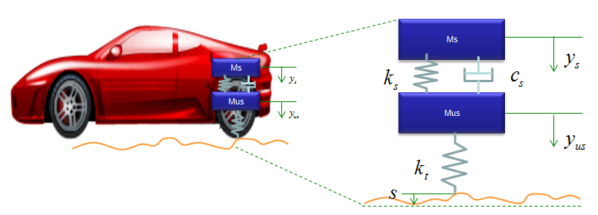
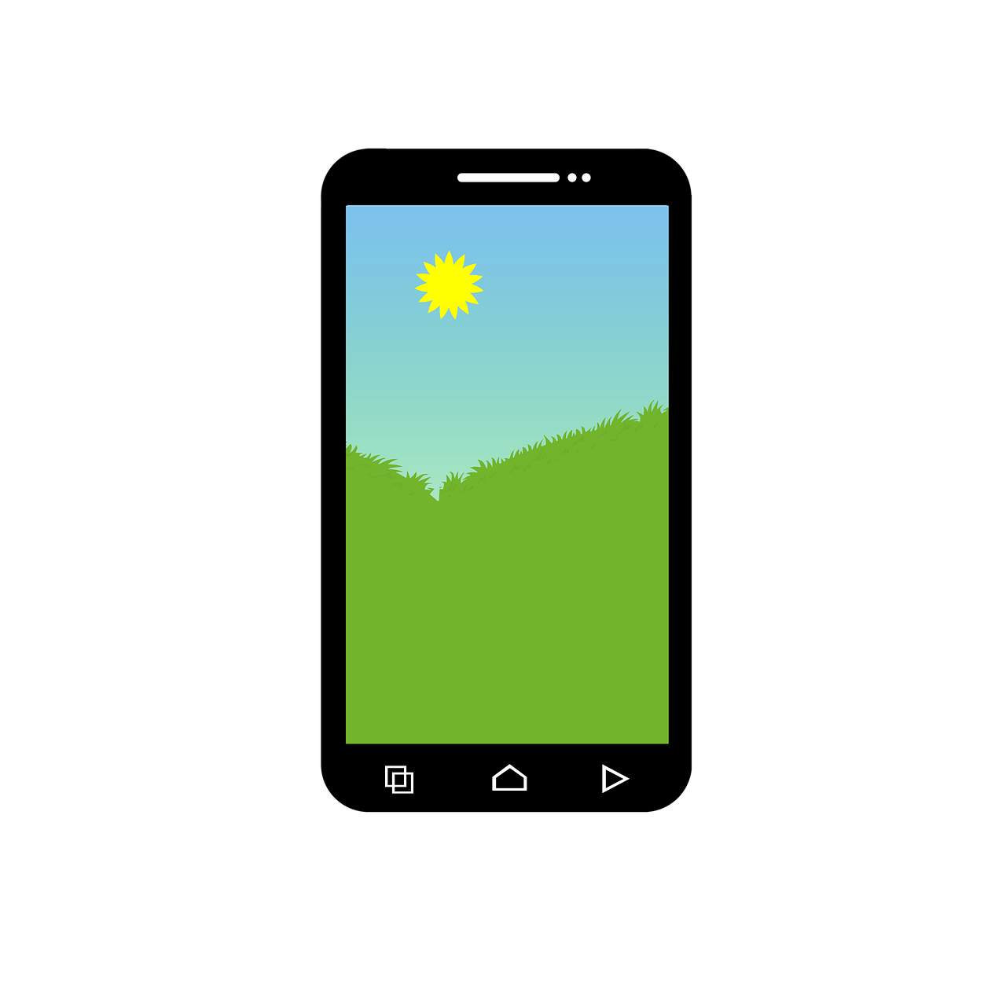
Project Overview
Android phone attached to dash of vehicle, collecting accelerometer and GPS data
Accelerometer data allows us to solve differential equation to find total displacement of pavement
Average pavement displacement per distance is International Roughness Index (IRI) (in/mi, cm/km, etc.)
Frontend can send and receive data with server
Database used to store all route and user data
http://www.sharetechnote.com/html/DE_Modeling_Example_SpringMass.html
Notes:
Joe

Slide 4
Functional Requirements
Application must record GPS and Accelerometer data from device sensors
Create log of routes driven, relevant data
Calculate IRI of routes
Must support a minimum of Android Nougat
Account system with user login
Database using MongoDB to maintain route data
NodeJS server to assist with realtime IRI calculation
Route data stored locally when cellular connection is weak
Ability to upload saved data for analysis when connection is restored
Notes:
Joe

Slide 5
Non-Functional Requirements
Logging
Failed login attempts stored for auditing
Any runtime error should be logged for local file evaluation
Server
Server software must be independent of server OS
Must be able to handle up to 20 simultaneous users
App should be “easy” to use while user is driving vehicle
Notes:
Joe

Slide 6
Assumptions and Limitations
Assumptions:
Accurate IRI calculations may be performed using only accelerometer data
Calculations will be done real time
Data will be collected at a constant speed, using a conventional consumer vehicle, on flat, paved roads
Limitations:
Less accurate than Class 1 Profilometers
Requires an Android smartphone
Intensive calculations may limit numbers of users supported by server
Cellular signal may disconnect from server, making calculations not real time
Varying hardware and sensor accuracy may affect calculated IRI
Notes:
joe

Slide 7
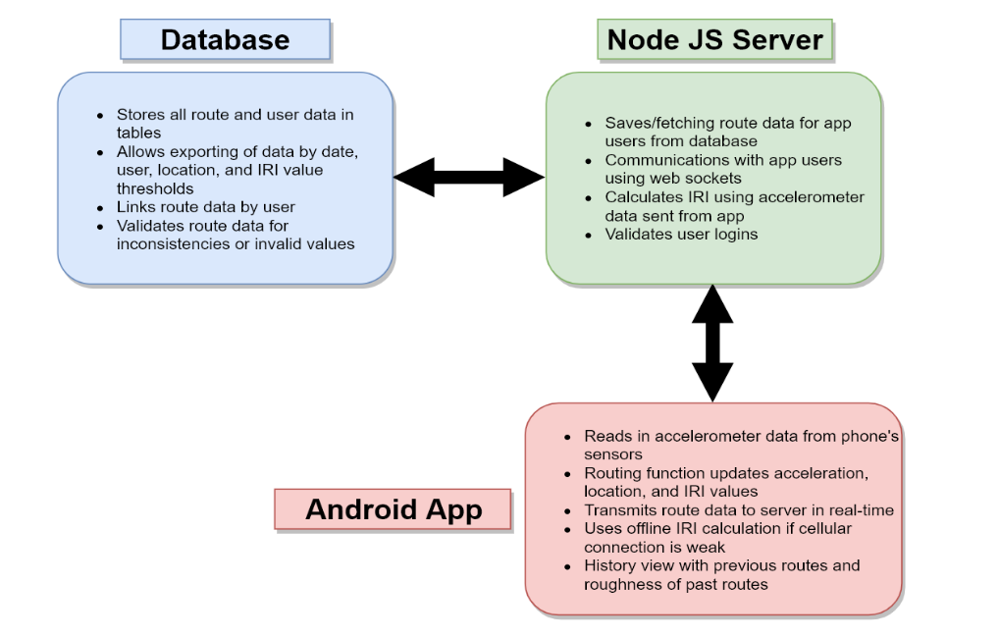
Conceptual Design Diagram
Notes:
kyle

Slide 8
Project Plan: Need Assessment
Road conditions can negatively impact vehicle health
Repairs up to $1000
Damage to tires, wheels, shocks and struts, etc.
Driver safety also at risk
Loss of control
Current profiling solutions pitfalls
Inaccurate
Expensive
Operating time
Statistics of damage to vehicles caused by road imperfections
http://news.aaa-calif.com/news/pothole-damage-costs-drivers-3-billion-annually-nationwide
Notes:
Kyle

Slide 9
Project Plan: Task Breakdown
Create Node.JS server.
Create database with formats for data types and attributes.
Link server and database for data r/w functionality.
Develop user-interface for Android app.
Create networking framework for frontend to communicate with backend.
Develop IRI calculation algorithm for available input data.
Implement algorithm on backend and frontend.
Add GPS tracking and logging to Android app.
Couple GPS and IRI data to create route histories.
System/acceptance testing with frontend, backend, and database.
Notes:
Kyle
risk

Slide 10
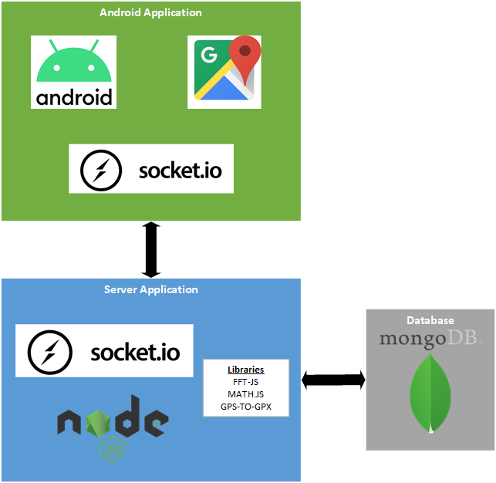
System Design: Libraries and Frameworks
Notes:
Greg
Client Device - Android, Google Maps, Socket.io to communicate to server
Server - Socket.io to communicate to client device, nodeJS, FFT-JS, MATHJS, GPS-to-GPX
Database - MongoDB

Slide 11
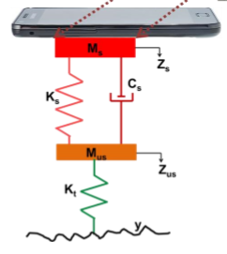
System Design: Roughness Calculation
Based on Quarter Car model
International Roughness Index (IRI)
Total vertical displacement over distance traveled
Inputs gathered by smartphone
Vertical acceleration
Latitude, longitude
Time
GPS speed
Inputs gathered through calculation
Vertical velocity and displacement
Road profile (unsprung displacement)
Distance between points
Notes:
Tanner

Slide 12
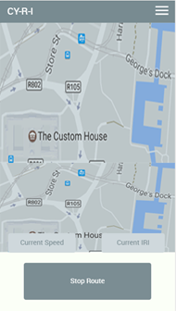
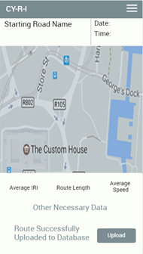
System Design: User Interface
Login/Signup
User ID and password
Route Recording
Map at current location
Overview of route data
Route History
View previous routes
Each has their own route details view
Route Details
In depth data of route
Map view with route overlayed
Settings
Input current vehicle type
Calibrate phone sensor based on orientation
Notes:
Christian

Slide 13
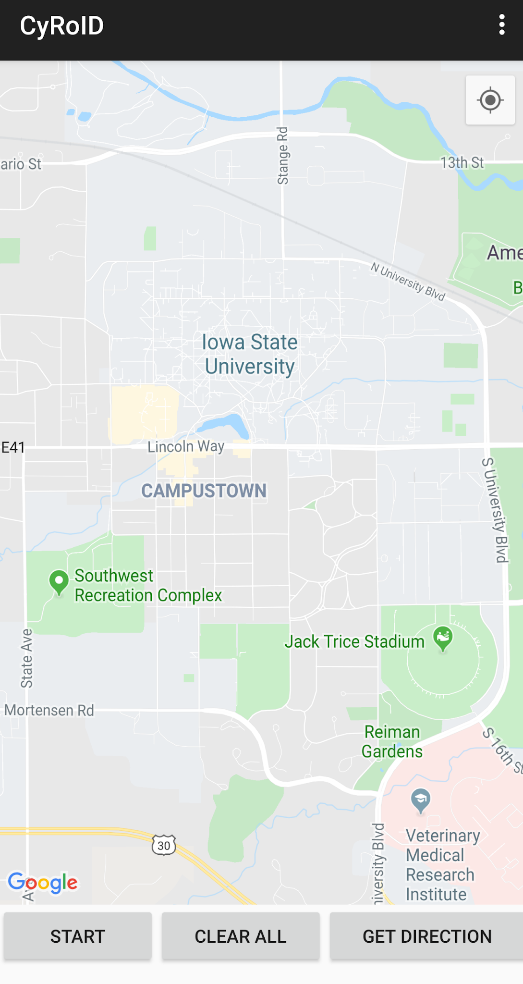
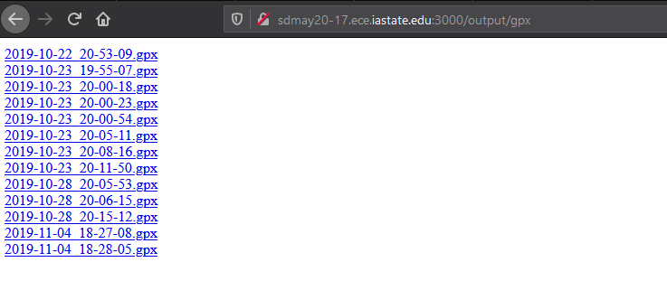
Current IRI Calculation Prototype
Working with google maps to collects data
Sends data to express server in gpx and csv format
Calculating IRI both on app and server
Notes:
Justin

Slide 14
Project Plan: Milestones
Progress tracked through completed tasks
Each task will be associated with an issue on Git
One or more members assigned to a task
Milestones
Marked as releases corresponding to end of each AGILE development cycle
Milestone 1: Validated IRI Roughness Calculation Model.
Milestone 2: Alpha Version of Platforms Complete.
Milestone 3: Refine Software Solutions using Test Results.
Milestone 4: System and Acceptance Testing Complete.
Notes:
Greg
Milestone 1: Validated IRI Roughness Calculation Model. This will be considered complete when the model is proven to be correct and outputs accurate IRI values using location and accelerometer data taken from a smartphone.
Milestone 2: Alpha Version of Platforms Complete. The Android application and server contain implementations of all core functionalities derived from functional requirements. Unit test suites for each feature are established as outlined in Section 5 of this document.
Milestone 3: Refine Software Solutions using Test Results. This release will be the combination of bug-fixes and improvements to alpha software until it satisfies most functional and non-functional requirements. Integration tests should also be performed here.
Milestone 4: System and Acceptance Testing Complete. At this point, all aspects of solution have been validated and approved to meet all requirements outlined by client and in this document.

Slide 15
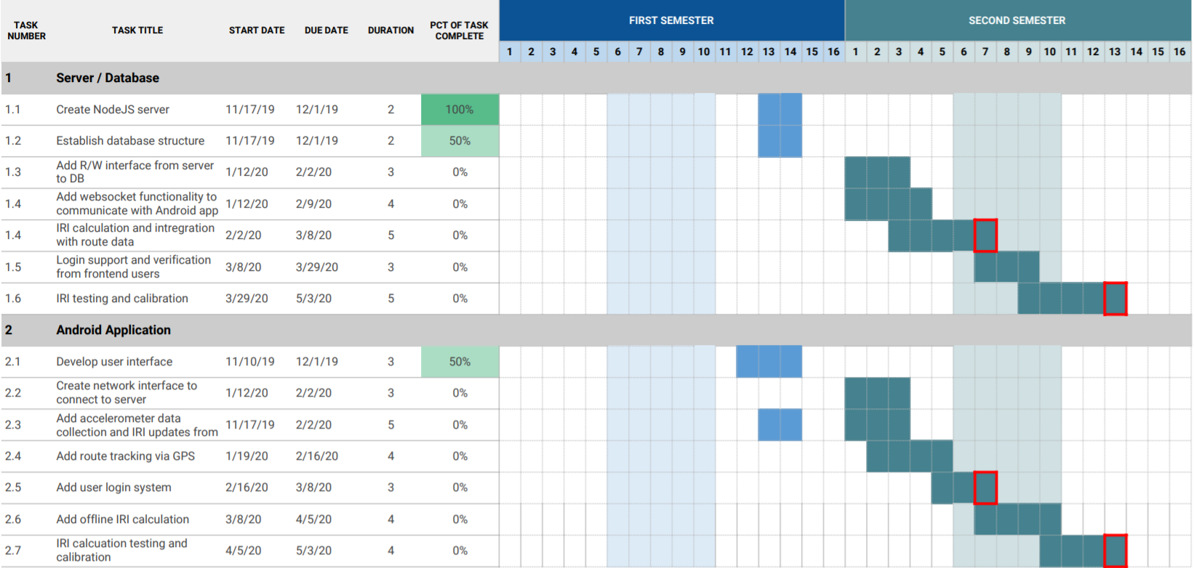
Project Plan: Schedule
Gantt Chart of Project Schedule for Spring 2020 Semester
Notes:
Greg

Slide 16
Test Plan: Methodology
Each requirement is associated with test case(s)
Cases may represent >1 physical test
Successful test results in all cases verifies software functionality outlined in requirement
Software tests will be developed iteratively
Same schedule as feature development in tasks
Per interface/module
Follows 4-layer software testing life cycle: Unit, Integration, System, Acceptance
Upper level tests require lower level modules to be verified
Notes:
Tanner

Slide 17
Test Plan: Tools and Frameworks
Android Application
Device Emulation
Rapid development and debugging
Test application on various device/OS configurations
Espresso
Tests using application’s user interface
Automate UI interactions for rapid prototyping
JUnit
Repeatable unit tests on software modules
Android Profiler
Measure resource usage of application in real time
Includes CPU, memory, battery, and network
Node.js Server
Mocha
JavaScript unit tests
Test runtime option to evaluate module performance
@Test
public void greeterSaysHello() {
onView(withId(R.id.name_field)).perform(typeText("Steve"));
onView(withId(R.id.greet_button)).perform(click());
onView(withText("Hello Steve!")).check(matches(isDisplayed()));
}
Espresso test example of UI element interaction
Notes:
Tanner
Android application

Slide 18
Test Plan: Specification Examples
Requirement | Description | Expected Outcome | Level | Environment
7 | Data inserted into database from server should be immediately available to pull by corresponding get function. | Server shall immediately request data after insertion. Data shall match inserted data in values and format. | Integration | Mocha
5 | Call user creation function with known username and password. | Server shall return success on insertion of new user into database. | Integration | Mocha
11 | Server and frontend shall be rebuilt on fresh systems to ensure no underlying paid software was previously used. | Systems should be able to be setup and operated on clean systems with no premium software or programs installed. | Non-Functional | Server Computer, Android Device
Example test specifications for requirements. For all entries, see Section 5 of Design Document
Notes:
Tanner

Slide 19
Conclusions
Current project status
Node server is configured and has ability to track and record routes sent from Android app (Socket.IO)
Proof of concept Android app records acceleration and location data of route
Developed by
Data will be used to test IRI calculations
Driven route visualized on Google Map after route is finished
Next semester work statement
Implement state-space IRI algorithm and validate
Layout UI for final application and port completed functionalities
Complete development tasks listed on schedule
Be able to scroll through previous saved routes
Notes:
Justin,

Slide 20
Conclusion: Individual Efforts
Team Member | Contributions
Greg Starr | Route drawing with intermediate points
Christian Royston | Application UI design and implementation
Kyle Eckrich | Backend implementation and server communication
Joe Van Treeck | Android app, IRI calculation experimentation
Justin Kuennen | Android application design, backend communication
Tanner Dempsay | Server setup, server to client communication testing, testing procedures and framework research, IRI calculation research

Slide 21
Questions?
Notes:
Christian

Slide 22
Quarter Car Model
S. Islam, "Development of a smartphone application to measure pavement roughness and to identify surface irregularities," PhD diss., University of Illinois at Urbana-Champaign, 2015.
Notes:
Extra

Slide 23
Functional Requirements
Project requires an Android app representing the front end for the user, and a server for the backend.
Android app must take accelerometer data from the device’s onboard sensors.
App must log the route taken by the user during the roughness measuring.
Data acquired shall include GPS coordinates, accelerometer values in all axes, and IRI values among each step of the route.
System shall use a user-based system to identify app users.
The server shall be based on the NodeJS framework.
All relevant data relating to routes, users, etc. will be stored in a MongoDB database system.
Application shall have minimum API support for Android Nougat and newer versions of Android.
Application shall be able to calculate pavement roughness offline if the cellular connection is weak or nonexistent.
All data gathered during the route shall be saved on smartphone’s local storage in case of connection error.
Notes:
Extra

Slide 24
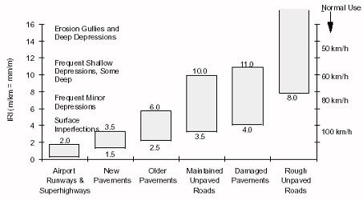
IRI Roughness Scale Example
M. W. Sayers, T. D. Gillespie, & C. A. V. Queiroz, “The international road roughness experiment: A basis for establishing a standard scale for road roughness measurements.” Transportation Research Record, 1084, 76-85. 1986
Notes:
Extra

Slide 25
Data Output Links on Server
GPX Files
CSV Files
Notes:
Extra

Slide 26
Financial Breakdown
Required Item | Count | Unit Cost | Total Cost
Android Phone | 3 | $50+ (Cheap Android phone prices may vary) | $0-150+
Server (Development phase) | 10 months | $0 (Provided by ETG) | $0
Phone Mount for Windshield | 3 | $20.00 | $60.00
Total |  |  | $60-$210
Notes:
Extra

Slide 27
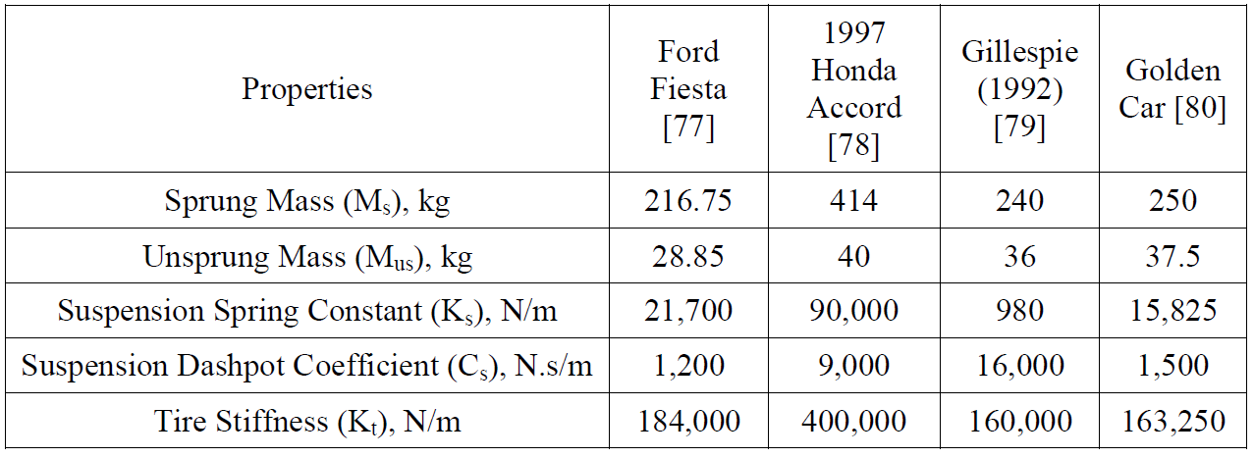
Common Coefficient Values on Vehicles

Slide 28
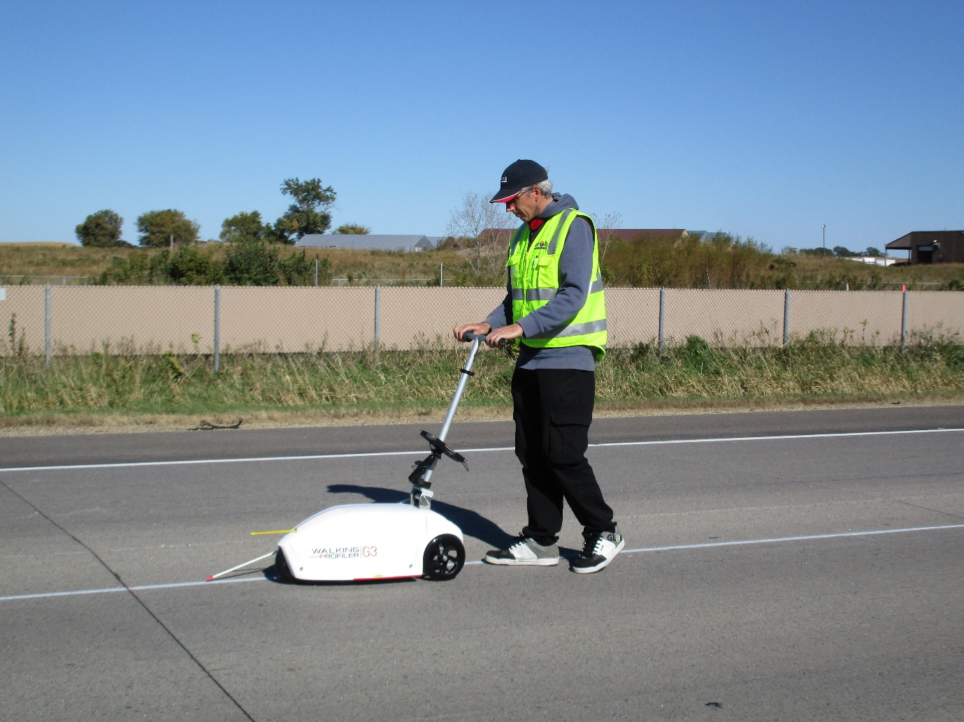
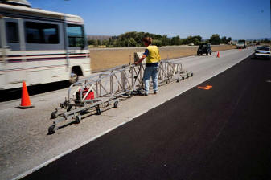
Other Profilometers
Profilograph
https://www.pavementinteractive.org/reference-desk/pavement-management/pavement-evaluation/roughness/
http://arrbgroup.net/products/walking-profiler-g3/

